Slide 1



Linked Lists: Insertion & Deletion
NullEntity

Slide 2

Contents
1. What is a Linked List
2. Nodes and Linked-List Structure
3. Types of Linked Lists
4. Traversal
5. Insertion
6. Deletion
7. Applications of Linked Lists & Pointer Manipulation & Common Errors
8. Advantages and Disadvantages
9. Project Overview and Source File
10. Conclusion
12. Group Members
11. References

Slide 3

What is a Linked List
A linked list is a linear data structure made up of connected nodes.
Each node stores data and a link/reference to another node.
Nodes do not need to occupy contiguous memory locations.
The first node is accessed through a pointer/reference called HEAD.
The last node points to NULL (or nullptr in modern C++).

Slide 4

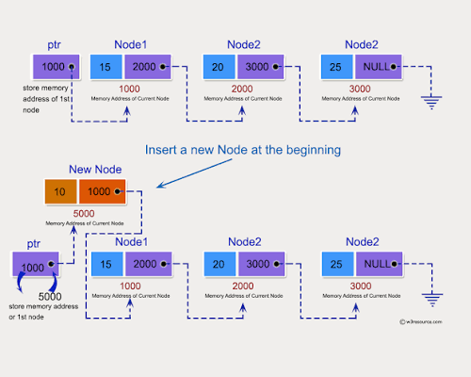
Nodes and Linked-List Structure
A node is the basic building block of a linked list.
In a singly linked list, a node contains:
  Data — the value being stored.
  Next — a pointer/reference to the next node.
HEAD stores the address/reference of the first node.

Slide 5




Types of Linked Lists
Linked lists fall into two categories: ordered lists and unordered lists. These domains describe how nodes can be arranged. Ordered lists are where nodes(elements) are organised based on a specific rule or order. Unordered lists are where the elements have no fixed arrangement
Singly Linked Lists
Doubly Linked Lists
Circular Linked Lists
The typical operations on a singly linked list are:
1. Initialize the list (to an empty state).
2. Determine if the list is empty.
3. Traverse the list (visit each node sequentially).
4. Insert an item in the list.
5. Delete an item from the list.
6. Search the list for a given item.
7. Update an item in the list.
8. Sort the list (in ascending or descending order).
9. Reverse the list.
10. Find the length of the list.
11. Copy the list.
12. Destroy the list.
The typical operations on a doubly linked list are:
1. Initialize the list.
2. Destroy the list.
3. Determine whether the list is empty.
4. Search the list for a given item.
5. Retrieve the first element of the list.
6. Retrieve the last element of the list.
7. Insert an item in the list.
8. Delete an item from the list.
9. Find the length of the list.
10. Print the list.
11. Make a copy of the doubly linked list
The typical operations on a circular linked list are:
1. Initialize the list (to an empty state).
2. Determine if the list is empty.
3. Destroy the list.
4. Print the list.
5. Find the length of the list.
6. Search the list for a given item.
7. Insert an item in the list.
8. Delete an item from the list.
9. Copy the list

Slide 6

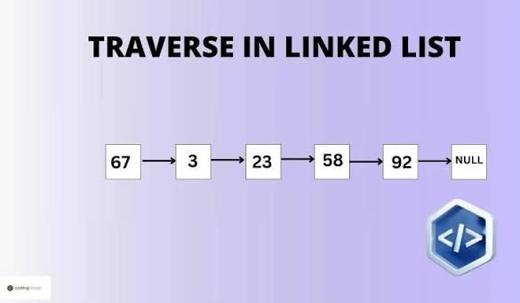
Traversal
Traversal means visiting nodes one by one, starting from HEAD.
A temporary pointer/reference moves from the current node to current->next.
Traversal is required when the desired position is not already known.
Searching or visiting all nodes normally takes O(n) time.

Slide 7

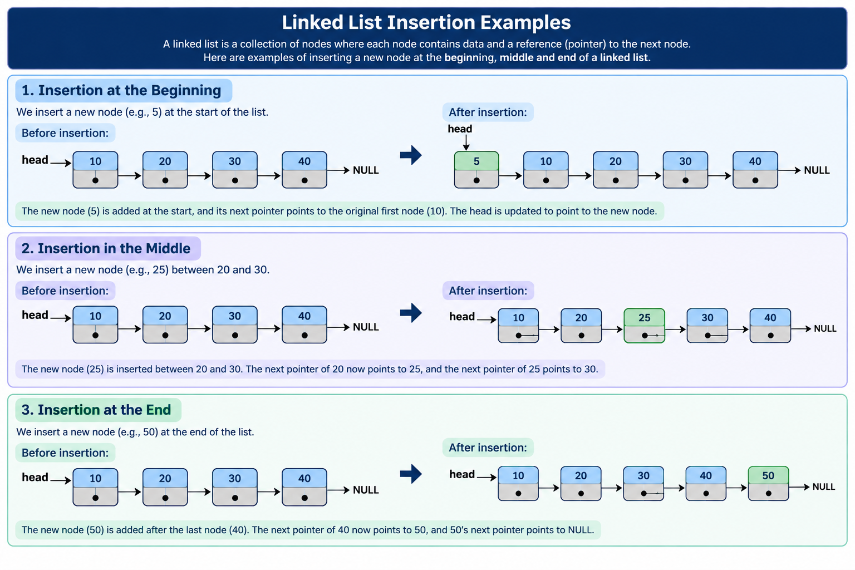
Insertion
Insertion means adding a new node to the linked list.
Common forms:
At the beginning (head)
At the end (tail)
At a specific position
Before or after a particular node
Insertion is mainly performed by creating a node and changing links.

Slide 8

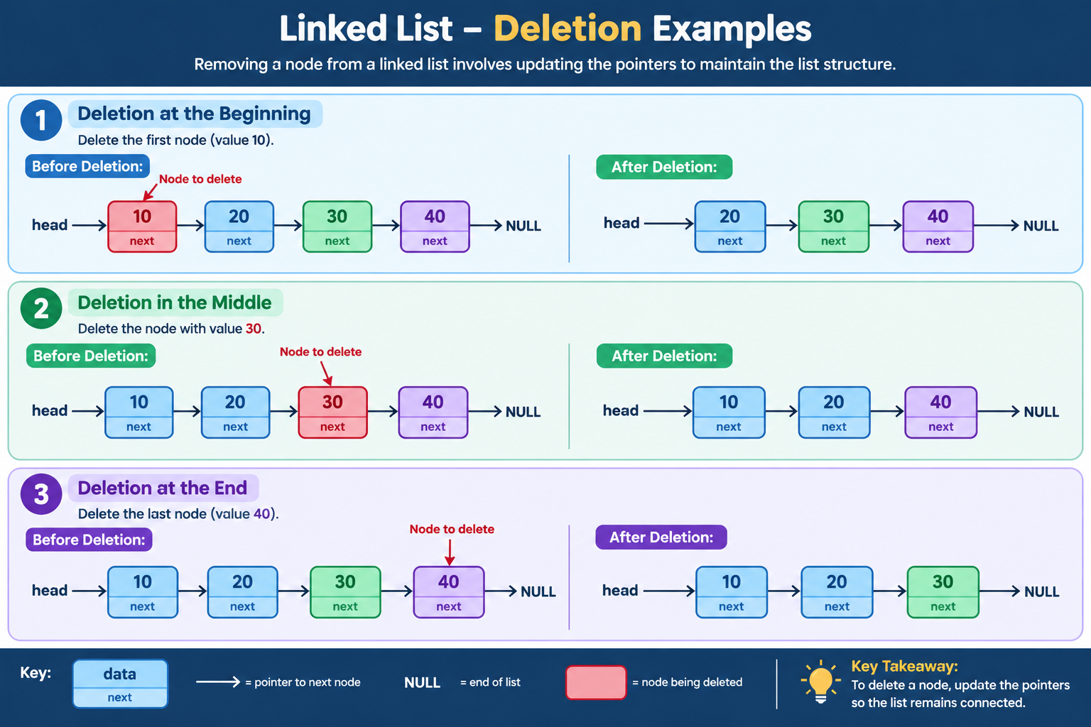
Deletion
Deletion means removing a node from a linked list.
Common forms:
Delete the first node
Delete the last node
Delete a node at a specific position
Delete a particular node
After deletion, the remaining nodes must remain correctly connected.
In C++, dynamically allocated nodes should be released appropriately.

Slide 9

Applications of Linked Lists
Pointer Manipulation & Common Errors
Linked lists are used in situations where a program needs to add and remove items while it is running. Unlike arrays, where inserting or deleting an item may require other elements to be shifted and the size is usually fixed, linked lists can grow or shrink dynamically. When an item is inserted or deleted, only a few pointers need to be changed.
Because of this flexibility, linked lists are used in several computer science applications. They can be used to implement stacks and queues, manage free memory lists in operating systems, and create features such as music playlists and browser back and forward navigation.
However, linked lists are less suitable when a program frequently needs to access an item by its position or index. To reach a particular node, the program normally has to start at the beginning of the list and follow the links from one node to the next.
The applications of linked lists can be grouped according to the type of linked list, such as singly linked lists, doubly linked lists, and circular linked lists.
Insertion and deletion depend on changing links correctly.
Common errors include:
  Losing the rest of the list by overwriting a link too early.
  Forgetting to update HEAD when inserting/deleting at the beginning.
  Leaving the last node pointing to an invalid location instead of NULL.
  Accessing a node after it has been deleted.
  Forgetting to reconnect the previous and next nodes after deletion.
Good pointer discipline prevents broken lists and memory errors.

Slide 10

Advatntages and Disadvantages
Advantages
Improved efficiency: The program automates key tasks, reducing the time required to complete them manually.
Accuracy: Automated processing can minimise human errors and produce more consistent results.
User convenience: The program provides a structured and accessible way for users to perform the required tasks.
Productivity: By simplifying repetitive processes, the program allows users to complete tasks more efficiently.
Consistency: The system applies the same programmed procedures to each input, ensuring consistent outputs.
Disadvantages
Dependence on technology: The program requires appropriate hardware, software, and a suitable operating environment to function effectively.
Input errors: Incorrect or incomplete information entered by the user may result in inaccurate outputs.
Limited functionality: The program can only perform tasks that have been incorporated into its source code.
Maintenance requirements: Software may require regular debugging, updating, and maintenance to remain functional and relevant.
User limitations: Users may require basic technical knowledge to operate the program correctly and interpret its results.

Slide 11

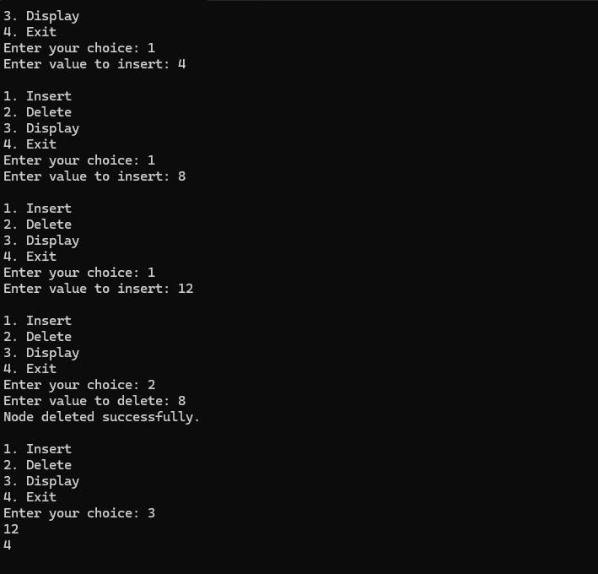
Project Overview and Source File
Testing the Linked List Program
We tested our linked list program by running its menu in a terminal. First, we inserted the values 4, 8, and 12. Since each new value is inserted at the front of the list, the values were stored in the order:
12 → 8 → 4
Next, we tested the deletion operation by deleting 8, which was located in the middle of the list. The program successfully removed the node and reconnected 12 directly to 4, displaying the message "Node deleted successfully."
Finally, we selected the option to display the list. The output showed:
12 → 4
This confirmed that both the insertion and deletion operations worked correctly and that the linked list maintained the correct connections between its nodes.
https://web-based-c-compiler.vercel.app/

Slide 12

Conclusion
Linked lists are dynamic data structures made up of interconnected nodes, where each node stores data and a pointer or reference to another node. This presentation covered the structure and types of linked lists, including singly, doubly, and circular linked lists, as well as the importance of traversal when accessing or searching for nodes. It also examined insertion and deletion, including operations at the beginning, end, and middle of a list, which are performed by adjusting links rather than shifting elements.
The presentation also highlighted the importance of pointer management, as incorrect manipulation can result in lost nodes, invalid memory access, or broken lists. Although linked lists provide efficient O(1) insertion and deletion when the required node or position is already known, finding a position may require O(n) traversal. They also require additional memory for pointers and do not provide direct access to elements like arrays.
Overall, understanding nodes, links, traversal, insertion, deletion, and pointer manipulation allows programmers to use linked lists effectively and determine when they are an appropriate data structure for applications that require dynamic data and frequent insertion and deletion.

Slide 13

References
Cormen, T.H., Leiserson, C.E., Rivest, R.L. and Stein, C.,2022. Introduction to Algorithms. 4th ed. Cambridge: MIT Press.
Goodrich, M.T., Tamassia, R. and Goldwasser, M.H.,2020. Data Structures and Algorithms in Python. Hoboken: Wiley.
Sedgewick, R. and Wayne, K., 2020. Algorithms. 4th ed. Boston: Addison-Wesley.
Malik, D.S. 2018. C++ programming: Program design including data structures. 8th ed. Boston, MA: Cengage Learning.
https://www.geeksforgeeks.org/c/c-program-to-implement-singly-linked-list
cppreference.com (n.d.) std::forward_list. Available at: (Accessed: 26 September 2026).
Stanford University (2024) CS106B: More Linked Lists. Available at: Stanford CS106B — More Linked Lists (Accessed: 26 September 2026).
University of Chicago (n.d.) Systems Programming I: Lecture 9 — Linked Lists. Available at: University of Chicago — Linked Lists Lecture (Accessed: 26 September 2026).
University of Maryland, Baltimore County (n.d.) Linked List. Available at: UMBC — Linked List Lecture (Accessed: 26 September 2026).
University of Southern California (n.d.) Linked Lists. Available at: USC — Linked Lists Notes (Accessed: 26 September 2026).
University of Illinois Urbana-Champaign (2024) ECE 220: Linked Lists. Available at: University of Illinois — ECE 220 Linked Lists (Accessed: 26 September 2026).

Slide 14


Group Members
Initials | Surname | Student Number
RM | Sekgobela | 53949463
OJS | Matseke | 44693389
R | Mogajane | 51797364
A | Madubye | 54385997
P | Pheto | 46776028
O | Gopane | 52549216
K | Monaheng | 55937373
F | Maepa | 48229946
T | Tswaile | 51208806
T | Skall | 51526379
T | Chauke | 51524600
The End

